Slide 1
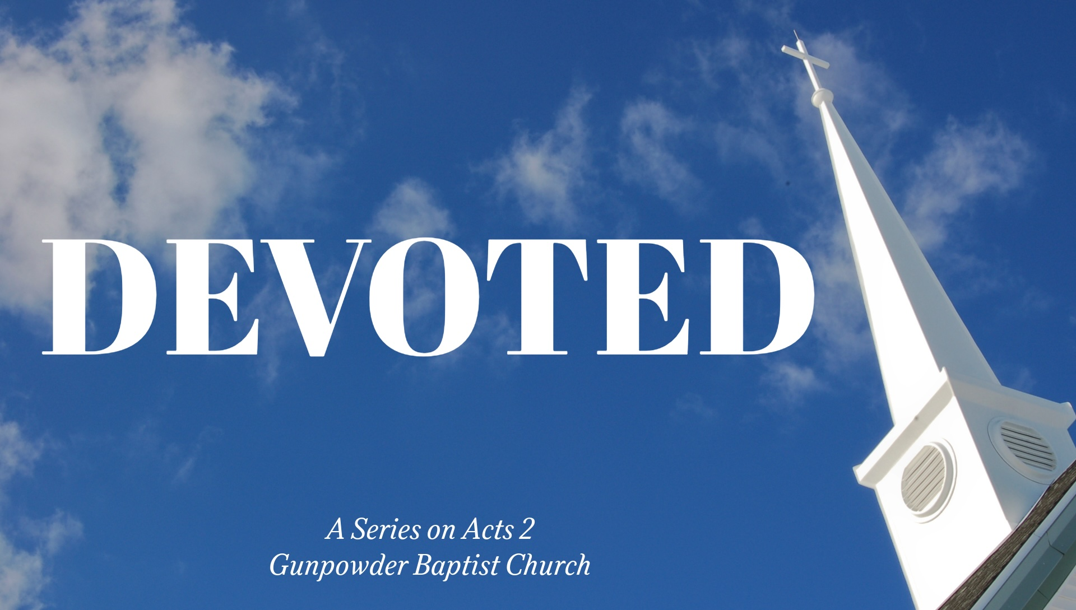

Slide 2
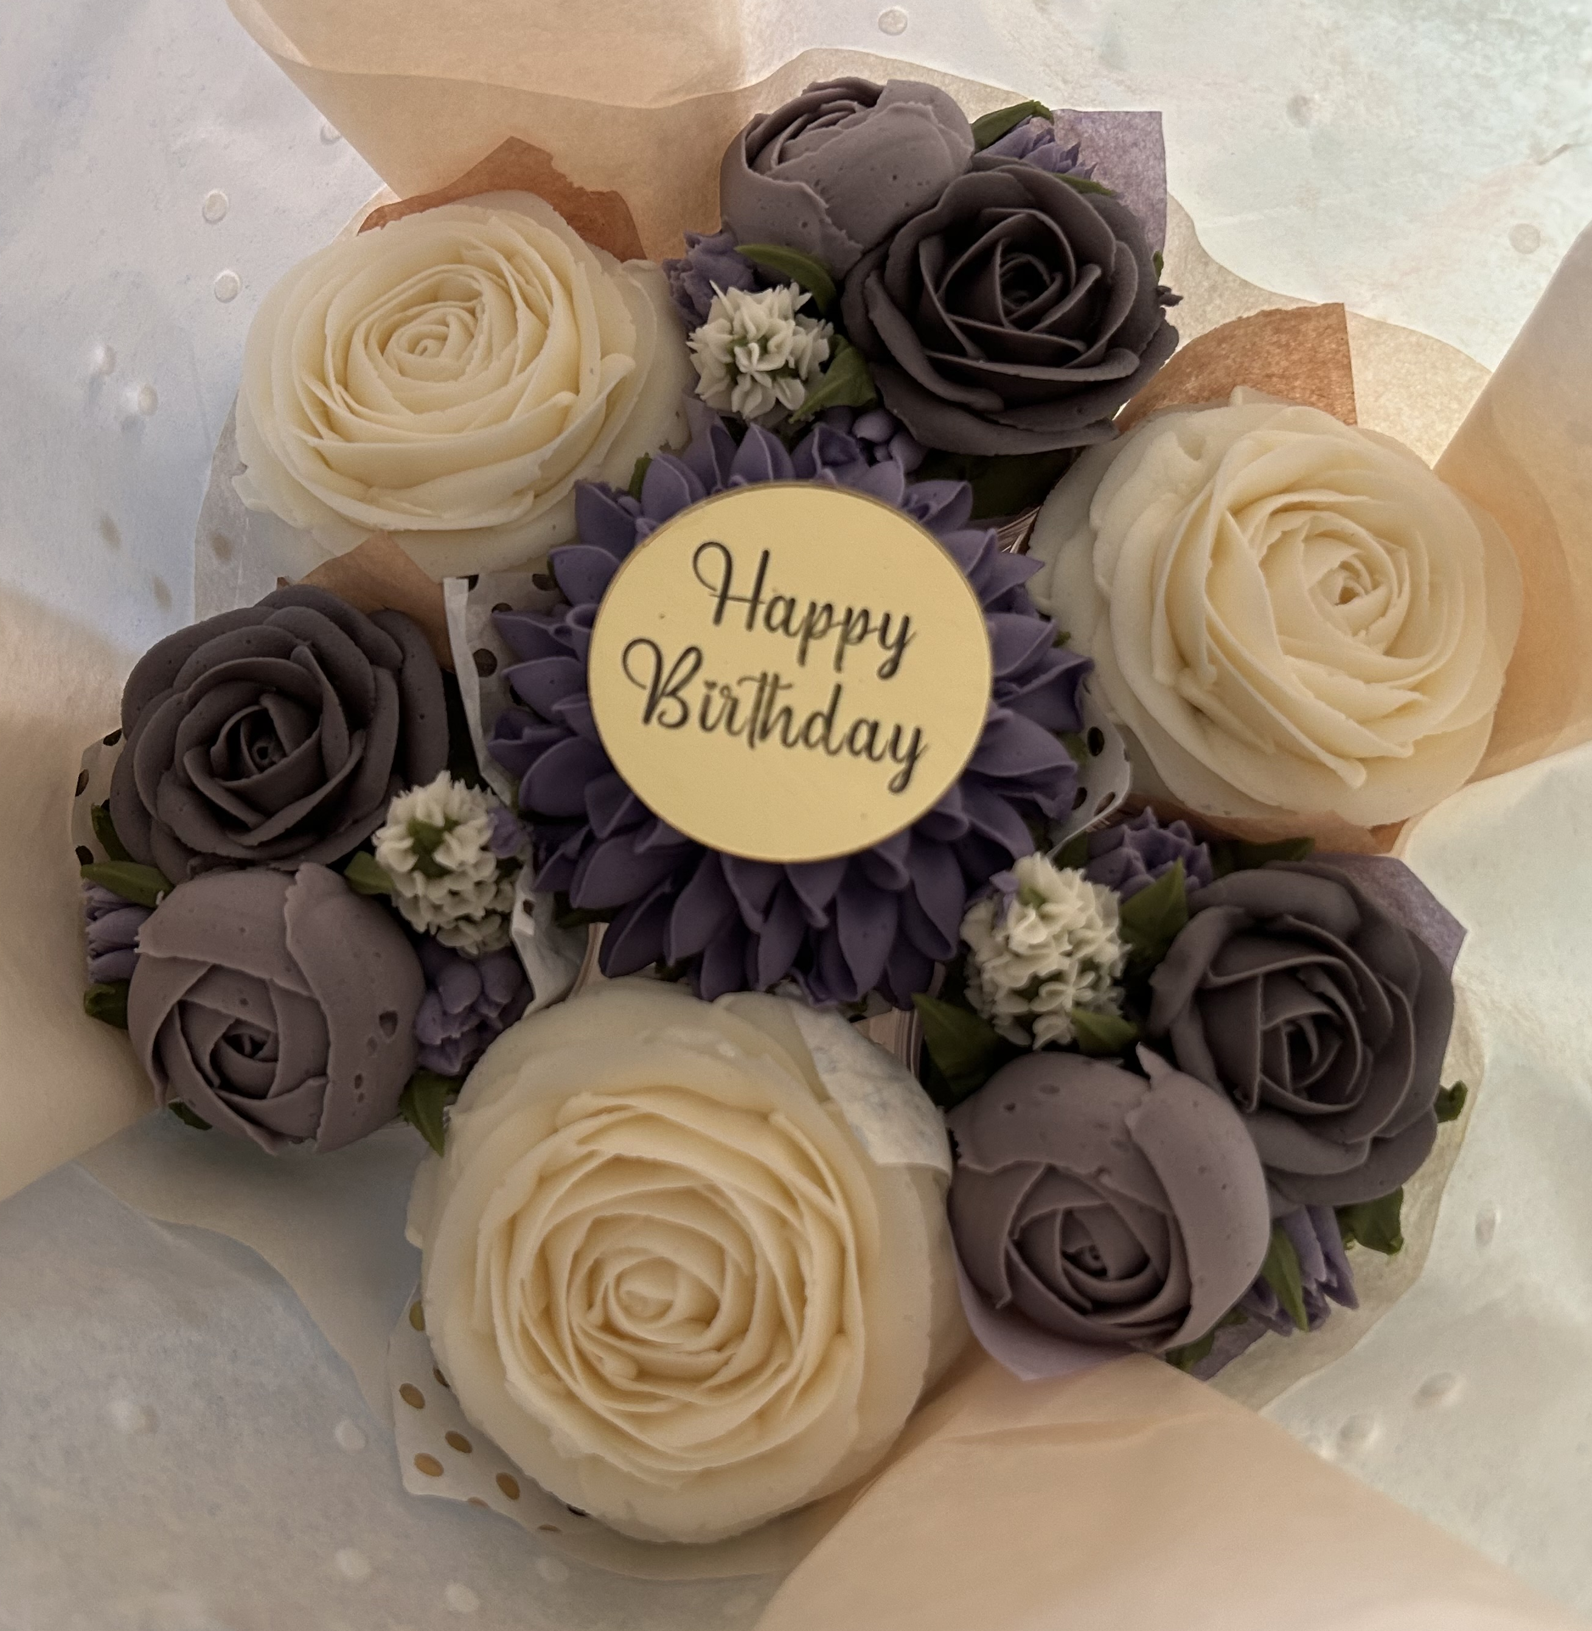
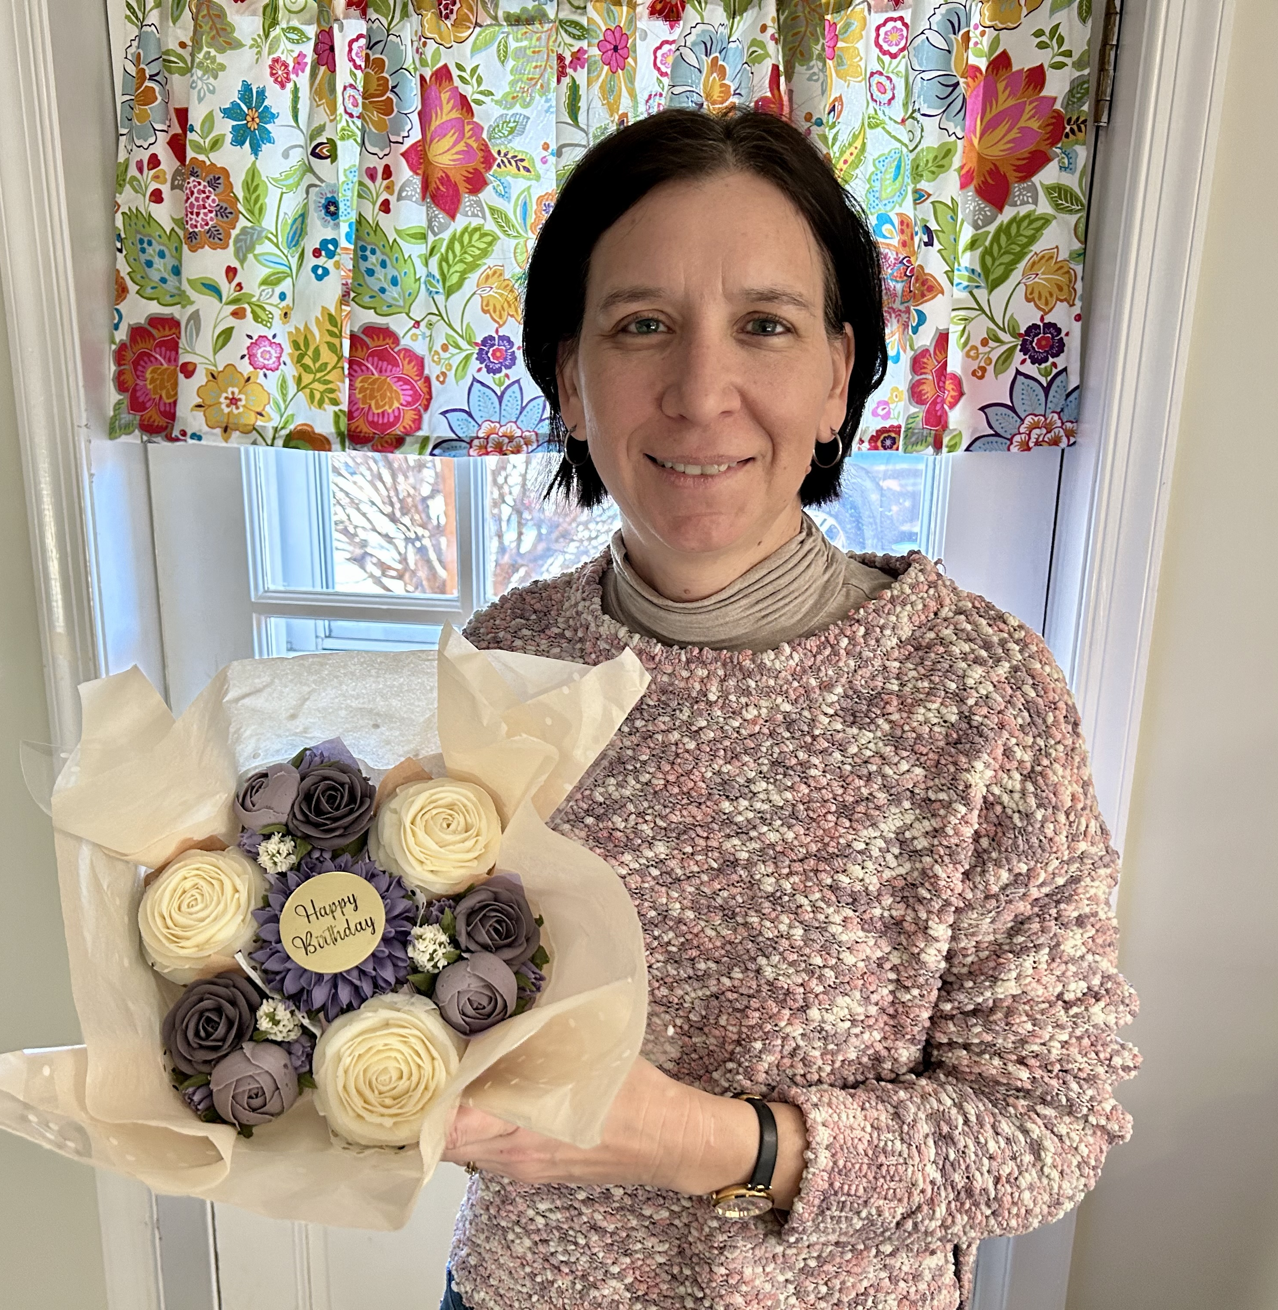
\

Slide 3
Pentecost
was the Birthday
of the Church.

Slide 4
Background
In the Jewish calendar, Passover remembers Israel’s deliverance from Egypt when the Passover lamb was killed, and the blood was applied to the doorways.
The Feast of Pentecost occurs 50 days later (Leviticus 23:15-16), and another offering is presented called Firstfruits - literally the first grain of the season.

Slide 5
Timeline
Jesus rose from the dead on Easter Sunday.
Jesus showed Himself to people for 40 days.
Before He ascended, Jesus said to wait.
The disciples waited in the Upper Room 10 days.
On the day of Pentecost, the Holy Spirit came.

Slide 6
Symbolism
Passover celebrates leaving the slavery of Egypt because blood was shed, and Pentecost remembers Mt. Sinai where the nation received the law as a sign of God’s covenant.
Jesus died as the Passover Lamb to save us from sin. However, instead of a law written on stones, at Pentecost God put His Spirit into the hearts of His people.

Slide 7
Story
When everyone was together in one place, the Spirit came with wind and fire.
Empowered by this divine presence, the disciples spoke in other languages, and Peter preached about Jesus.
Peter told the crowds that God had kept His promise and that they needed to repent.

Slide 8
Name
The “Church” was born with the coming of the Spirit on the 120 waiting in the Upper Room.
3,000 then responded to the message of Peter and were added to the “Church.” (vs.41)
The name “Church” means “Called Out,” but the implication is “Called Together.”

Slide 9
Lesson
These first believers started meeting together and following the commands of the Lord.
They were baptized to identify with Jesus. They also practiced the Lord’s Supper to remember what Jesus had done.
Their days were spent together praying, serving, teaching, learning, and giving.

Slide 10
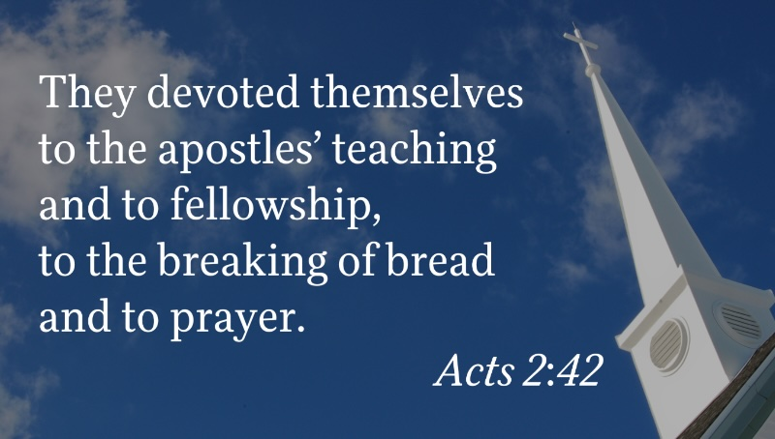

Slide 11
Main Point
A Genuine Decision Leads To
Godly Devotion.

Slide 12
Devoted Series
Baptism - January 11
Lord’s Supper - January 18
Giving - January 25
Teaching - February 1
Leaders - February 8
Fellowship - February 15
Prayer - February 22

Slide 13
Today, a person is added to the church when he or she is born again, and the Spirit brings new life inside.

Slide 14
Conclusion
Have you made a genuine design to follow Jesus?
Do you practice a devotion to Jesus and His commands?

